Slide 1


Kian Mohseni
May 21, 2023

Slide 2

Outline
Executive Summary
Introduction
Methodology
Results
Conclusion

Slide 3
Executive Summary
Summary of methodologies
Data Collection through API
Data Collection with Web Scraping
Data Wrangling
Exploratory Data Analysis with SQL
Exploratory Data Analysis with Data Visualization
Interactive Visual Analytics with Folium
Visual Dashboard with Plotly Dash
Machine Learning Prediction
Summary of all results
Exploratory Data Analysis
Interactive Visual Analytics
Predictive Modeling

Slide 4
Introduction
Project background and context:
Space X advertises Falcon 9 rocket launches on its website, with a cost of 62 million dollars; other providers cost upward of 165 million dollars each, much of the savings is because SpaceX can reuse the first stage. Therefore, if we can determine if the first stage will land, we can determine the cost of a launch. This information can be used if an alternate company wants to bid against SpaceX for a rocket launch.
Problems we want to find answers:
What factors determine if the rocket will land successfully?
What is the relationship between various features that determine the success rate of a landing?
What operating conditions needs to be in place to ensure a successful landing program.

Slide 5

Section 1

Slide 6
Methodology
Executive Summary
Data collection methodology:
SpaceX Rest API and web scraping from Wikipedia
Perform data wrangling
One-hot encoding applied to categorical features
Perform exploratory data analysis (EDA) using visualization and SQL
Perform interactive visual analytics using Folium and Plotly Dash
Perform predictive analysis using classification models
Build, tune, and evaluate classification models

Slide 7
Data Collection
API
Web Scraping
Get data from SpaceX API
Convert data into pandas dataframe using json function
Filter dataframe by filling in missing values
Export to csv file
Web scraping from Wikipedia using BeautifulSoup function
Extract HTML table, parse table, and convert into pandas dataframe
Export to csv file

Slide 8

Data Collection – SpaceX API
We called the get request to the SpaceX API to retrieve the data, then converted it to a pandas dataframe, before finally cleaning and filling in any missing values.
The link to my notebook is https://github.com/kianmessi/SpaceX/blob/main/jupyter-labs-spacex-data-collection-api.ipynb

Slide 9

Data Collection - Scraping
We first used BeautifulSoup to scrape Falcon 9 launch records from Wikipedia, then parsed the data into a pandas dataframe.
The link to my notebook is https://github.com/kianmessi/SpaceX/blob/main/jupyter-labs-webscraping.ipynb

Slide 10

Data Wrangling
Exploratory data analysis was used to determine the training labels.
The number of launches at each site and number of each orbit were calculated
From the outcome column in the data, we created a landing outcome label and exported the results to a csv
The link to my notebook is https://github.com/kianmessi/SpaceX/blob/main/IBM-DS0321EN-SkillsNetwork_labs_module_1_L3_labs-jupyter-spacex-data_wrangling_jupyterlite.jupyterlite.ipynb

Slide 11
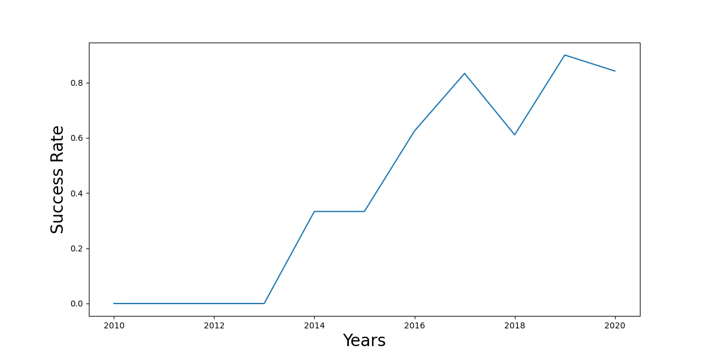
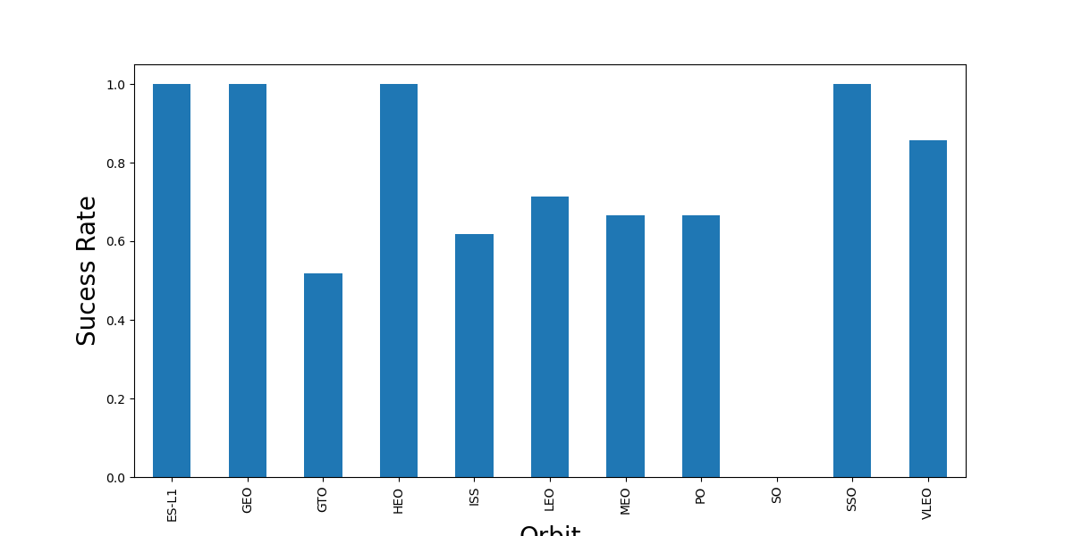
EDA with Data Visualization
We explored the data by visualizing the landing outcome success rate over the lats 10 years and the compared the success rates of each orbit type.
The link to my notebook is https://github.com/kianmessi/SpaceX/blob/main/IBM-DS0321EN-SkillsNetwork_labs_module_2_jupyter-labs-eda-dataviz.ipynb.jupyterlite.ipynb

Slide 12
EDA with SQL
The following SQL queries were executed to apply EDA on the data:
The failed landing outcomes in drone ship, their booster version and launch site names
The names of unique launch sites in the space mission
The total payload mass carried by boosters launched by NASA (CRS)
The total number of successful and failure mission outcomes
The average payload mass carried by booster version F9 v1.1
The link to my notebook is https://github.com/kianmessi/SpaceX/blob/main/jupyter-labs-eda-sql-coursera_sqllite.ipynb

Slide 13
Build an Interactive Map with Folium
We marked all launch sites, and added map objects such as markers, circles, lines to mark the success or failure of launches for each site on the Folium map.
Using the color-labeled marker clusters, we identified which launch sites have relatively high success rate (green being success and red being failure).
We calculated the distances between a launch site and its proximities, such as urban cities, highways, coastlines, etc.
The link to my notebook is https://github.com/kianmessi/SpaceX/blob/main/IBM-DS0321EN-SkillsNetwork_labs_module_3_lab_jupyter_launch_site_location.jupyterlite.ipynb

Slide 14
Build a Dashboard with Plotly Dash
Pie charts were used to display the total number of launches from each site.
Scatter plots show the relationship between landing outcome and payload mass for each launch instance.

Slide 15
Predictive Analysis (Classification)
We built our model by loading our data into a dataframe, transforming the data, splitting the data into training and test sets, set our machine learning algorithms and parameters to GridSearchCV, and fit our data sets to the objects to train our model
We evaluated the accuracy of each model and determined the best hyperparamters for each type of algorithm before plotting the Confusion Matrix
We continued to tune our models and found the best performing classification model based on the best accuracy score.
The link to my notebook is https://github.com/kianmessi/SpaceX/blob/main/IBM-DS0321EN-SkillsNetwork_labs_module_4_SpaceX_Machine_Learning_Prediction_Part_5.jupyterlite.ipynb

Slide 16
Results
Exploratory data analysis results
Interactive analytics demo in screenshots
Predictive analysis results

Slide 17

Section 2

Slide 18
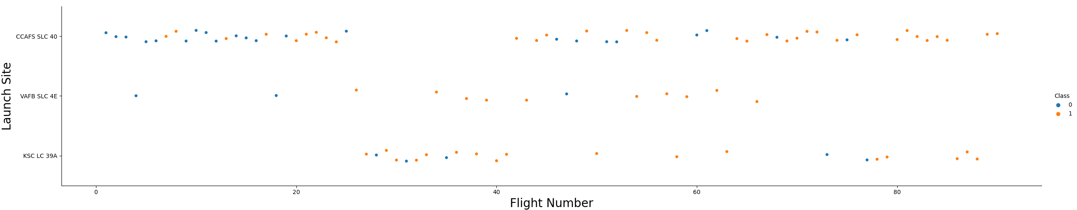
Flight Number vs. Launch Site
The plot shows us the greater the flight number at a launch site, the greater its success rate

Slide 19
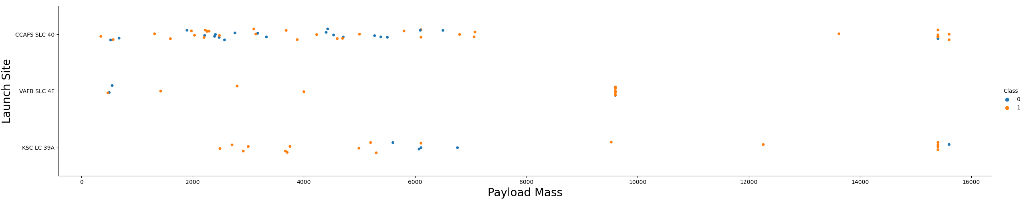
Payload vs. Launch Site
For each launch site, we can see that as Payload Mass increases, the higher the success rate of the landing generally.

Slide 20
Success Rate vs. Orbit Type
From the plot, we can see that ES-L1, GEO, HEO, SSO, and VLEO are the orbit types with the highest success rates.

Slide 21
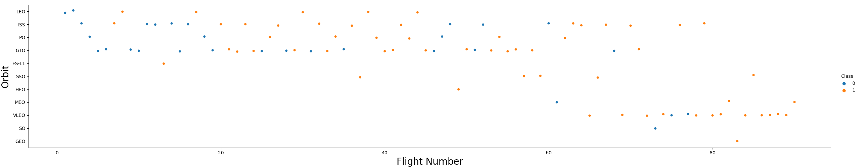
Flight Number vs. Orbit Type
The plot shows that in the LEO orbit, success is positively correlated to the number of flights however in the GTO orbit, there appears to be no relationship between success rate and number of flights.

Slide 22
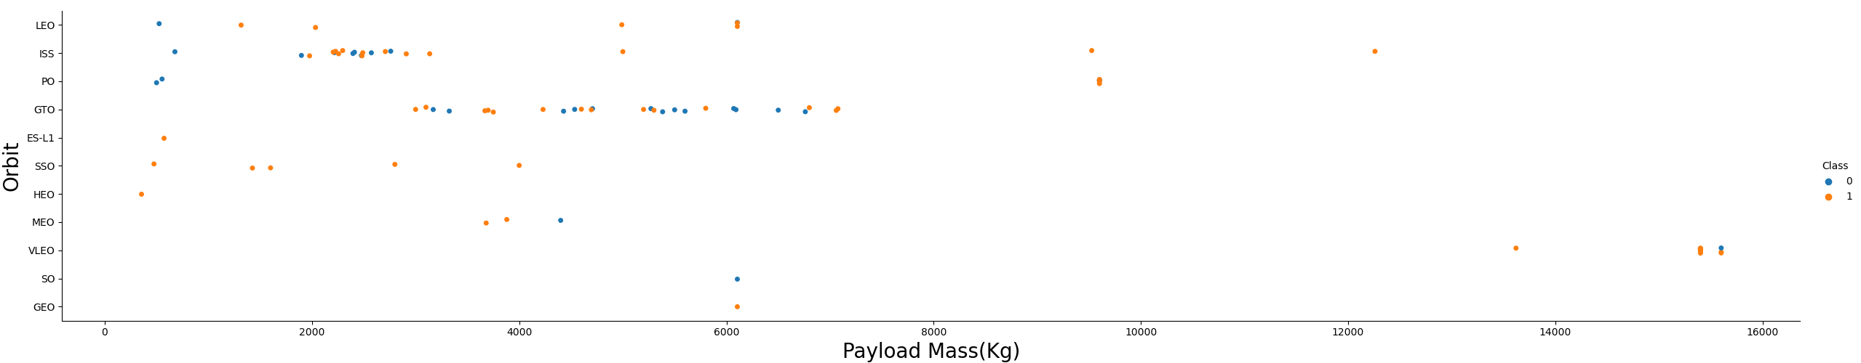
Payload vs. Orbit Type
It is shown that as payloads get heavier, the rate of successful landings increases for the LEO, ISS, and PO orbit types.

Slide 23
Launch Success Yearly Trend
The success rate of launches has steadily increased on average from the years of 2013-2020.

Slide 24

All Launch Site Names
The DISTINCT function was used in our query to show all the unique launch site names in the space mission.

Slide 25

Launch Site Names Begin with 'CCA'
This query was used to filter and display the first 5 records of launch sites that began with the string ‘CCA’.

Slide 26

Total Payload Mass
This query calculated the total payload mass carried by boosters launched by NASA (CRS) as 45,596 kg.

Slide 27

Average Payload Mass by F9 v1.1
This query calculated the average payload mass carried by booster version F9 v1.1.

Slide 28

First Successful Ground Landing Date
Query was used to list the date when the first successful landing outcome in ground pad was achieved.

Slide 29

Successful Drone Ship Landing with Payload between 4000 and 6000
In the query we used the WHERE and AND functions to filter and list the names of the drone ship landings that were successful and had payload mass greater than 4000 but less than 6000.

Slide 30

Total Number of Successful and Failure Mission Outcomes
In our query, we used the WHERE and % functions to list the total number of successful and failure mission outcomes of 100 and 1, respectively.

Slide 31

Boosters Carried Maximum Payload
We used a subquery with a MAX function in the WHERE function to list the names of the booster versions which have carried the maximum payload mass.

Slide 32

2015 Launch Records
In our query, we combined the WHERE, LIKE, AND, and BETWEEN functions to list the booster version, launch site, and landing outcome for all failed drone ship landing outcomes in the year of 2015.

Slide 33

Rank Landing Outcomes Between 2010-06-04 and 2017-03-20
In our query, we selected both landing outcomes and their COUNT in the data by using the WHERE function to filter for landing outcomes BETWEEN 2010-06-04 to 2017-03-20.
We applied the GROUP By and ORDER BY functions to order the grouped landing outcomes in descending order of their count.

Slide 34

Section 3

Slide 35

All Global Launch Sites
The map clearly shows that all SpaceX launch sites lie on either coast of the United States of America, particularly in Southern California and Eastern Florida.
Replace <Folium map screenshot 1> title with an appropriate title
Explore the generated folium map and make a proper screenshot to include all launch sites’ location markers on a global map
Explain the important elements and findings on the screenshot

Slide 36

Launch Site Successes and Failures
For the Florida Launch Site shown to the right (CCAFS SLC-40), the green markers indicate successful launches, while the red markers represent failed attempts.

Slide 37

Launch Site Proximities
The map shows the distance from the CCAFS SLC-40 launch site in Florida to the coast as 0.90 km. In general, we can see that all launch sites are located close to cities, but keep their distance from cities, railways, and highways.

Slide 38

Section 4

Slide 39

Success Percentage By Launch Site
Replace <Dashboard screenshot 1> title with an appropriate title
Show the screenshot of launch success count for all sites, in a piechart
Explain the important elements and findings on the screenshot

Slide 40

Highest Success Rate Launch Site

Slide 41

Launch Outcome vs Payload Across All Launch Sites

Slide 42

Section 5

Slide 43

Classification Accuracy
The Decision Tree classifier is the model with the greatest classification accuracy of 0.873

Slide 44
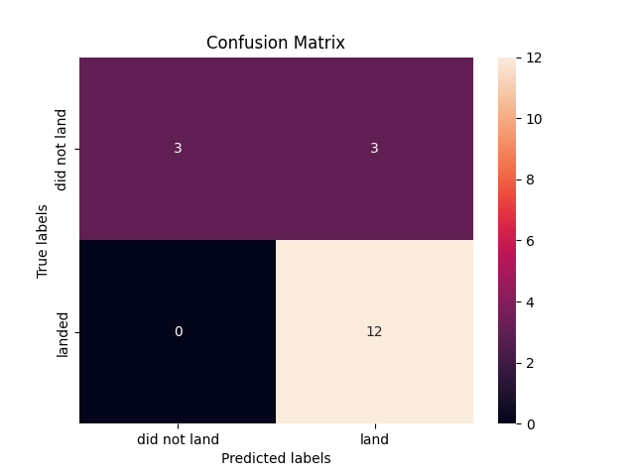
Confusion Matrix
The confusion matrix is used to show how the decision tree classifier can distinguish between the different classes, however the 3 false positives reported by the matrix are a cause for concern of its accuracy.

Slide 45
Conclusions
The larger the flight number at a launch site, the greater the success rate.
Launch success rate started to increase in 2013 till 2020.
Orbits ES-L1, GEO, HEO, SSO, VLEO had the most success rate.
Launch sites are located close to coastlines, but away from cities and highways.
KSC LC-39A had the most successful launches of any site.
Low weight payloads have higher success rates.
The Decision tree classifier is the best machine learning algorithm for our application, with only a few Type 1 errors.

Slide 46


